Slide 1

Clustering Barcelona
Ian Riera Smolinska

Slide 2
Clustering Barcelona
Cities are divided in administrative way. Can we divide it so it represents the demographic characteristics?
Is there any correlation between the different demographic parameters?
Find potential sources for modelling and predicting.

Slide 3
Data acquisition and cleaning
Statistics form the Barcelona city council about the different parameters. https://www.bcn.cat/estadistica/castella/dades/barris/tpob/pad/ine/a2019/ine17.htm
Foresquare API.
COVID-19 information https://aspb.shinyapps.io/COVID19_BCN/
73 neighborhoods, 8 different parameters to analyze

Slide 4
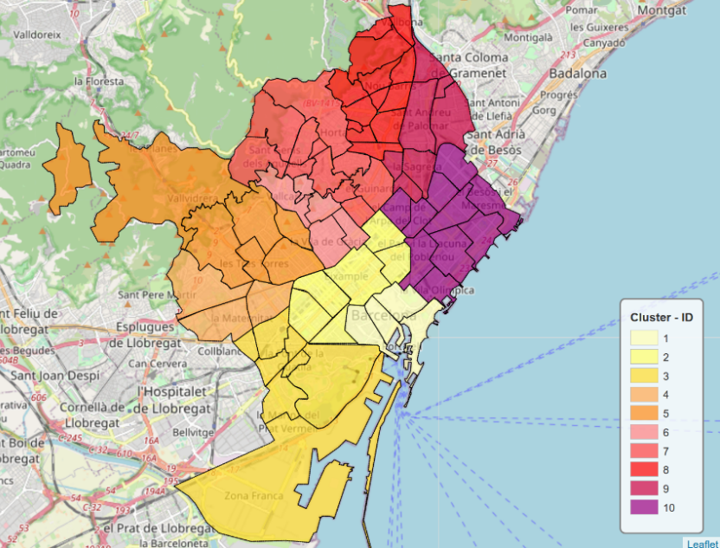
Current administrative division
Number | District | Size km² | Neighborhoods
1 | Ciutat Vella | 4.49 | La Barceloneta, El Gòtic, El Raval, Sant Pere, Santa Caterina i la Ribera
2 | Eixample | 7.46 | L'Antiga Esquerra de l'Eixample, La Nova Esquerra de l'Eixample, Dreta de l'Eixample, Fort Pienc, Sagrada Família, Sant Antoni
3 | Sants-Montjuïc | 21.35 | La Bordeta, la Font de la Guatlla, Hostafrancs, la Marina de Port, la Marina del Prat Vermell, El Poble-sec, Sants, Sants-Badal, Montjuïc*, Zona Franca - Port*
4 | Les Corts | 6.08 | les Corts, la Maternitat i Sant Ramon, Pedralbes
5 | Sarrià-Sant Gervasi | 20.09 | El Putxet i Farró, Sarrià, Sant Gervasi - la Bonanova, Sant Gervasi - Galvany, les Tres Torres, Vallvidrera, Tibidabo i les Planes
6 | Gràcia | 4.19 | Vila de Gràcia, el Camp d'en Grassot i Gràcia Nova, la Salut, el Coll, Vallcarca i els Penitents.
7 | Horta-Guinardó | 11.96 | El Baix Guinardó, El Guinardó, Can Baró, El Carmel, la Font d'en Fargues, Horta, la Clota, Montbau, Sant Genís dels Agudells, la Teixonera, La Vall d'Hebron.
8 | Nou Barris | 8.04 | Can Peguera, Canyelles, Ciutat Meridiana, La Guineueta, Porta, La Prosperitat, les Roquetes, Torre Baró, la Trinitat Nova, El Turó de la Peira, Vallbona, Verdum, Vilapicina i la Torre Llobeta
9 | Sant Andreu | 6.56 | Baró de Viver, Bon Pastor, El Congrés i els Indians, Navas, Sant Andreu de Palomar, La Sagrera i Trinitat Vella
10 | Sant Martí | 10.80 | El Besòs i el Maresme, el Clot, El Camp de l'Arpa del Clot, Diagonal Mar i el Front Marítim del Poblenou, el Parc i la Llacuna del Poblenou, Poblenou, Provençals del Poblenou, Sant Martí de Provençals, La Verneda i la Pau, la Vila Olímpica del Poblenou

Slide 5
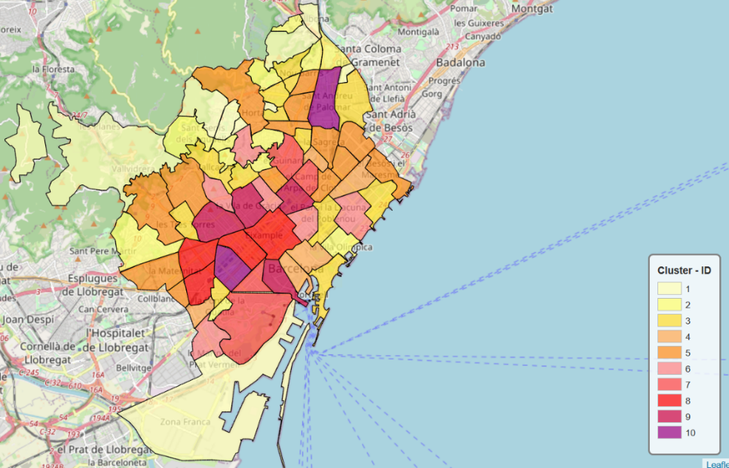
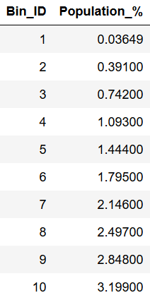
Population based division

Slide 6
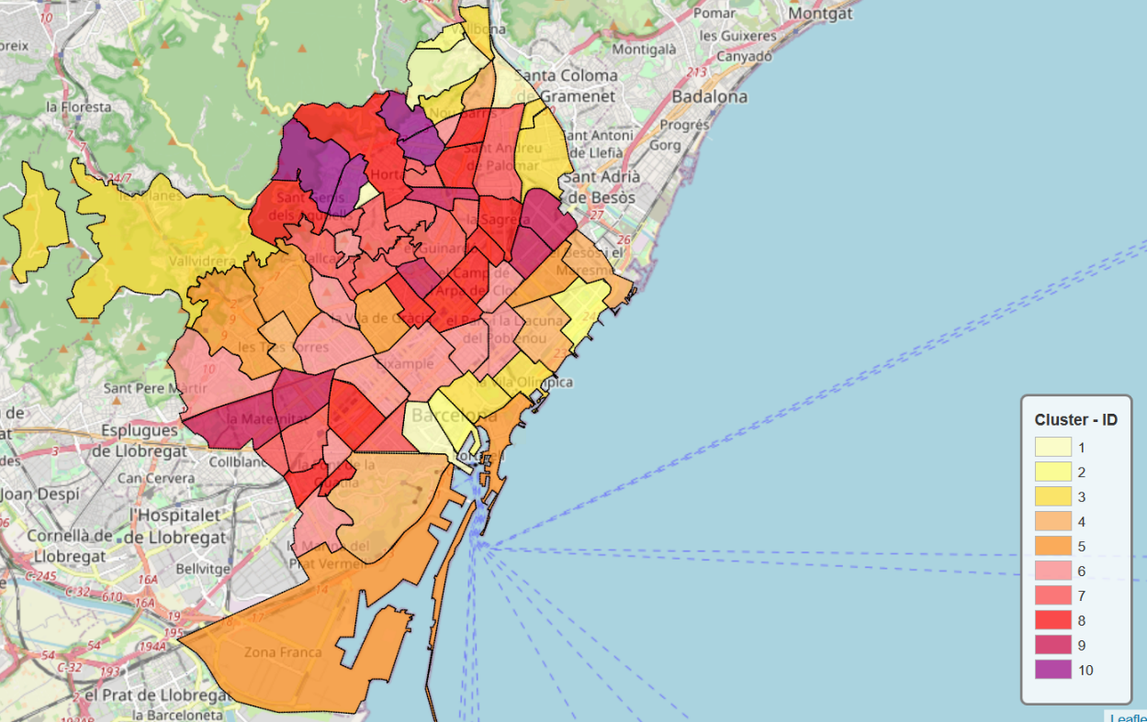
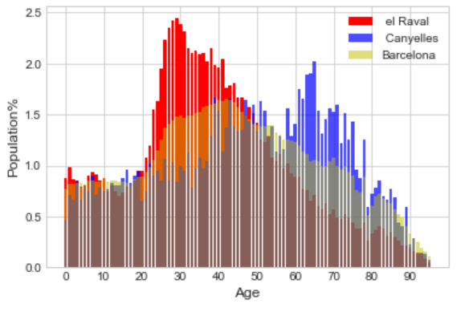
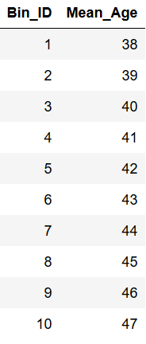
Age based division

Slide 7
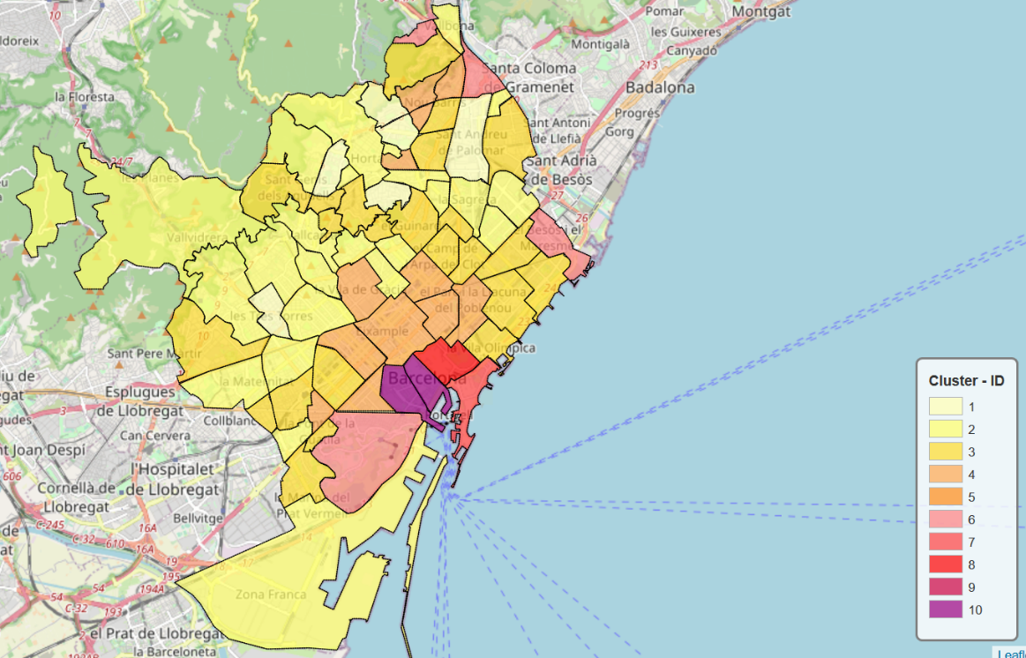
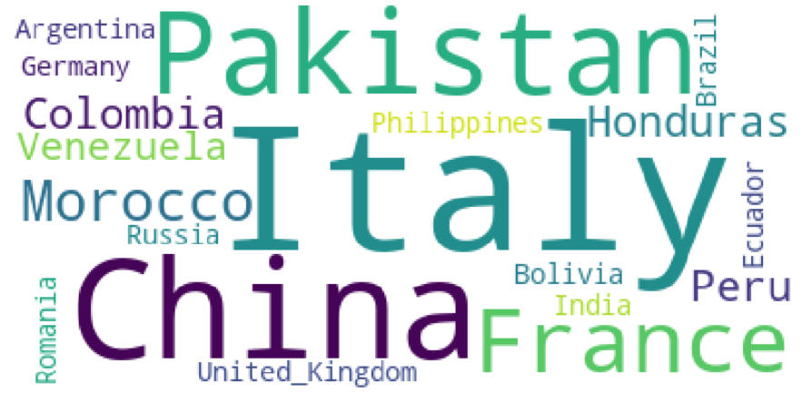
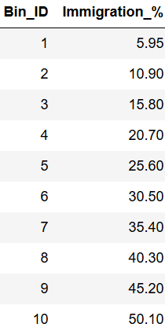
Nationality based division

Slide 8
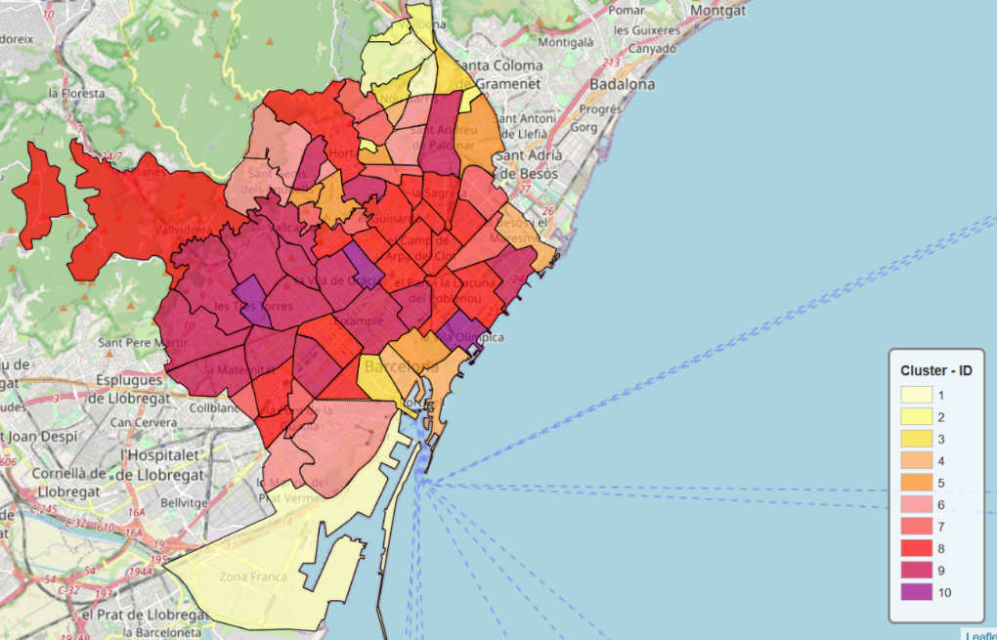
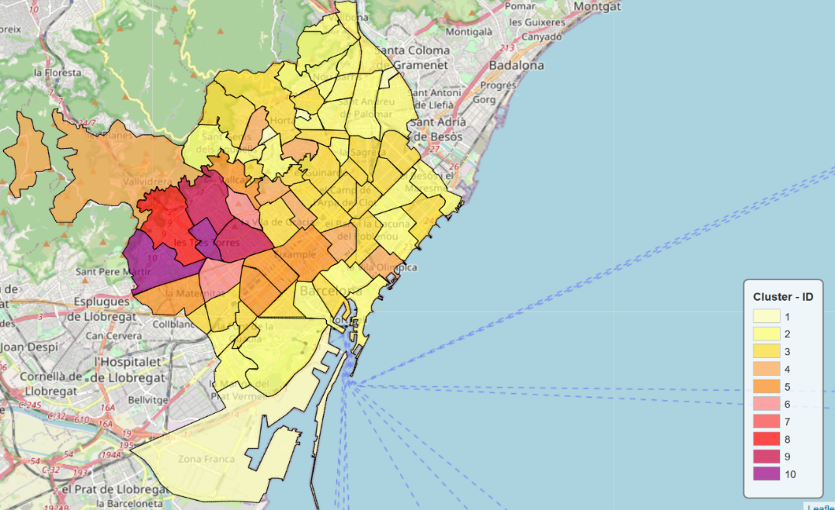
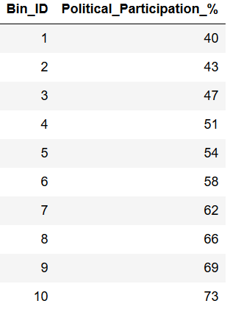
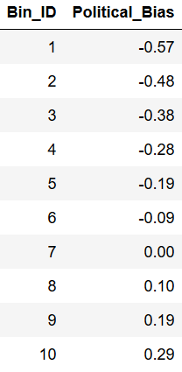
Politically based division
Being left political wing = -1 and right =+1

Slide 9
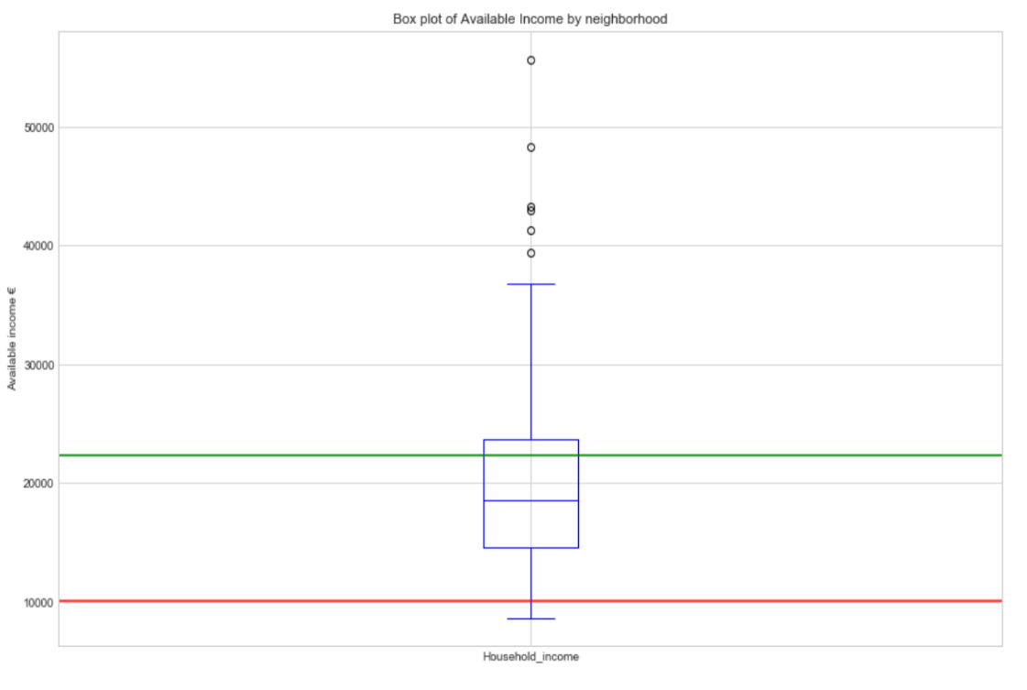
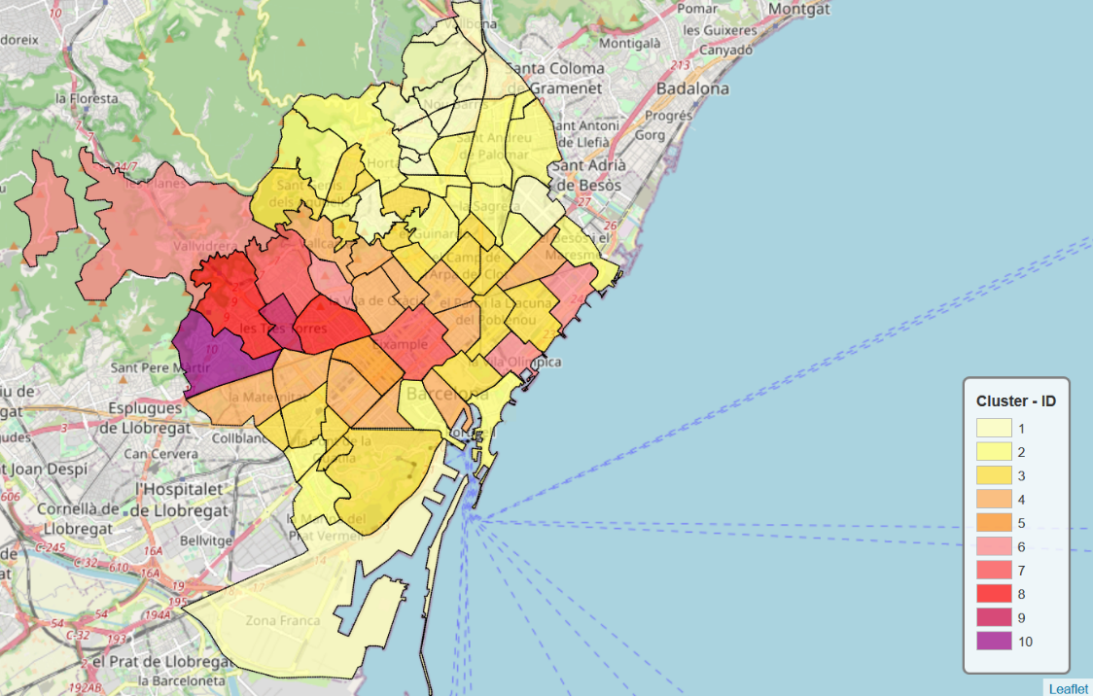
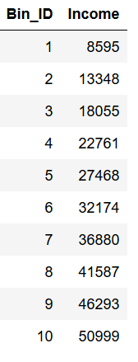
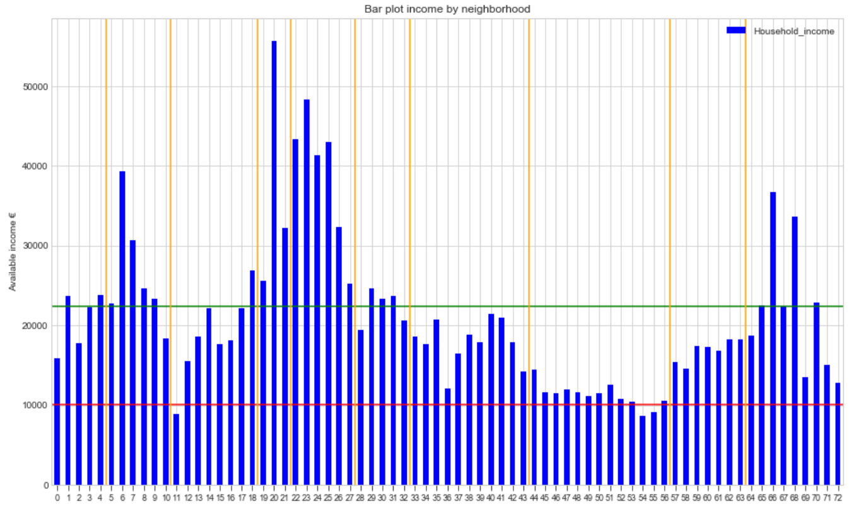
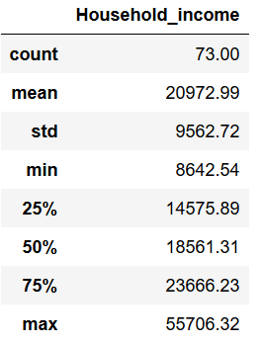
Household income division

Slide 10
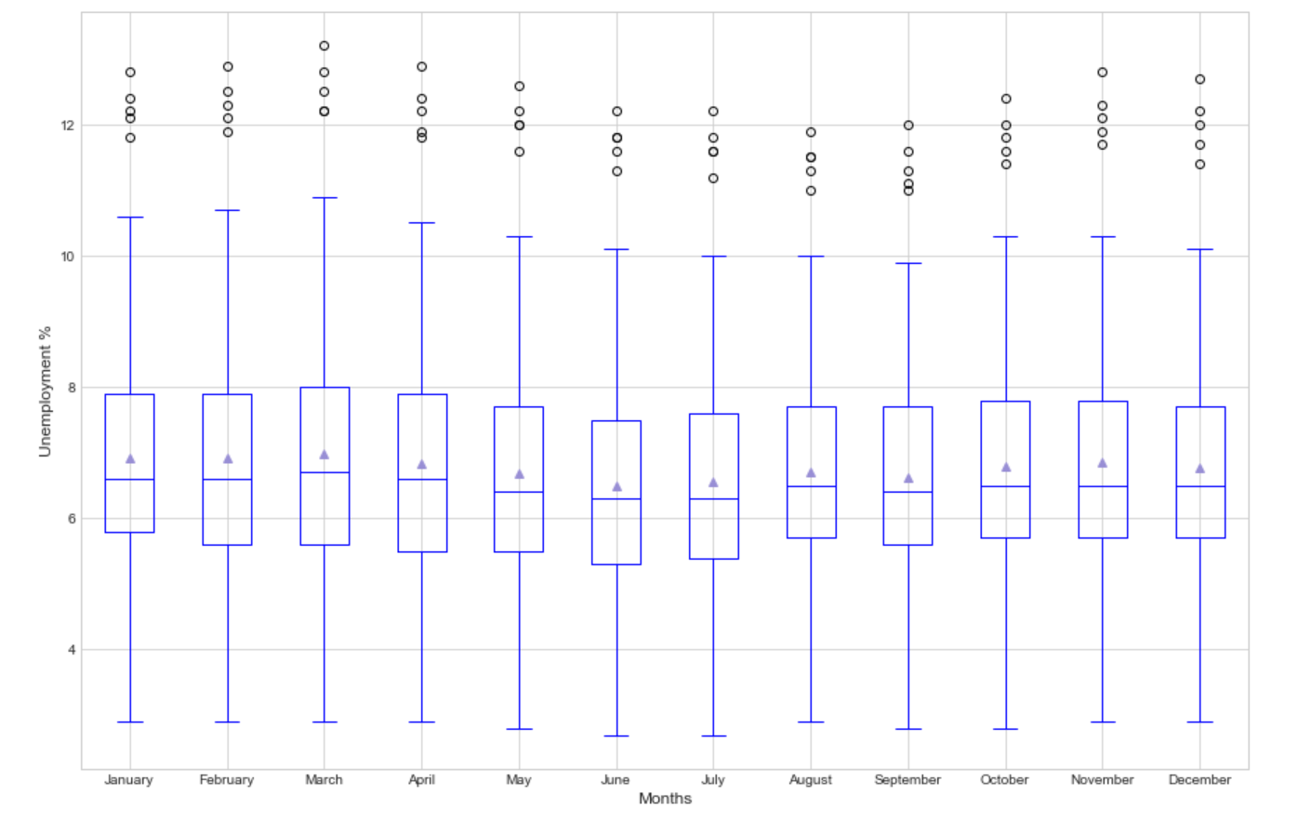
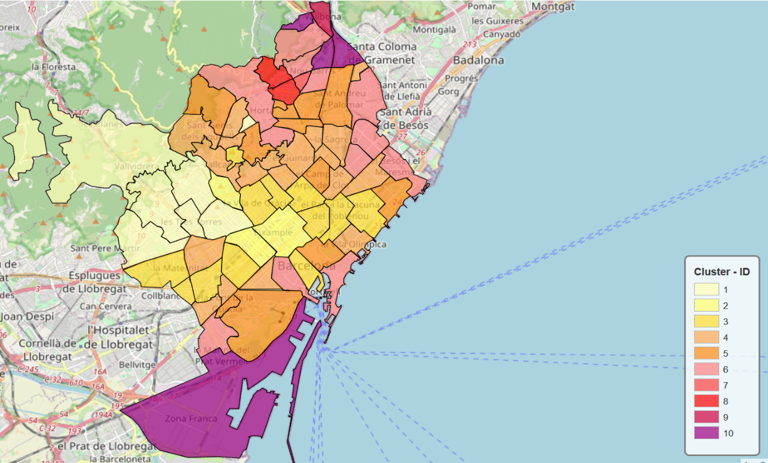
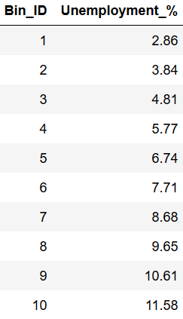
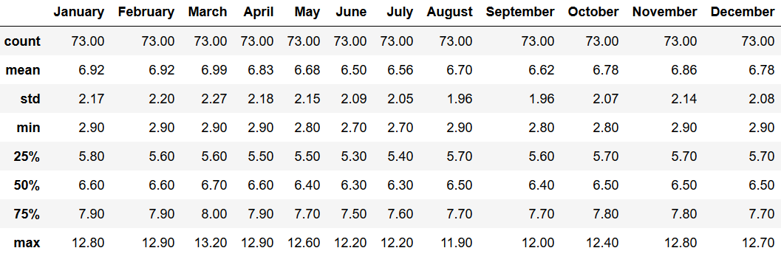
Unemployment based division

Slide 11
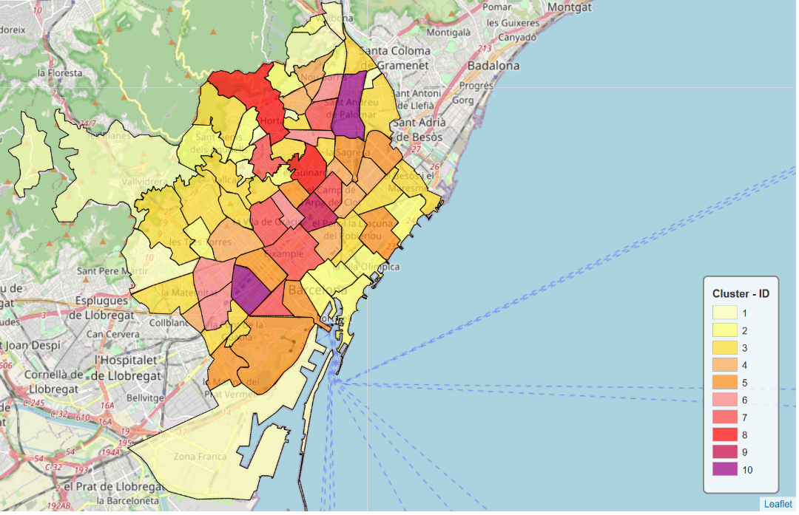
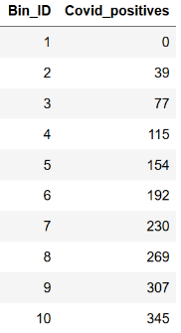
Covid-19 division

Slide 12
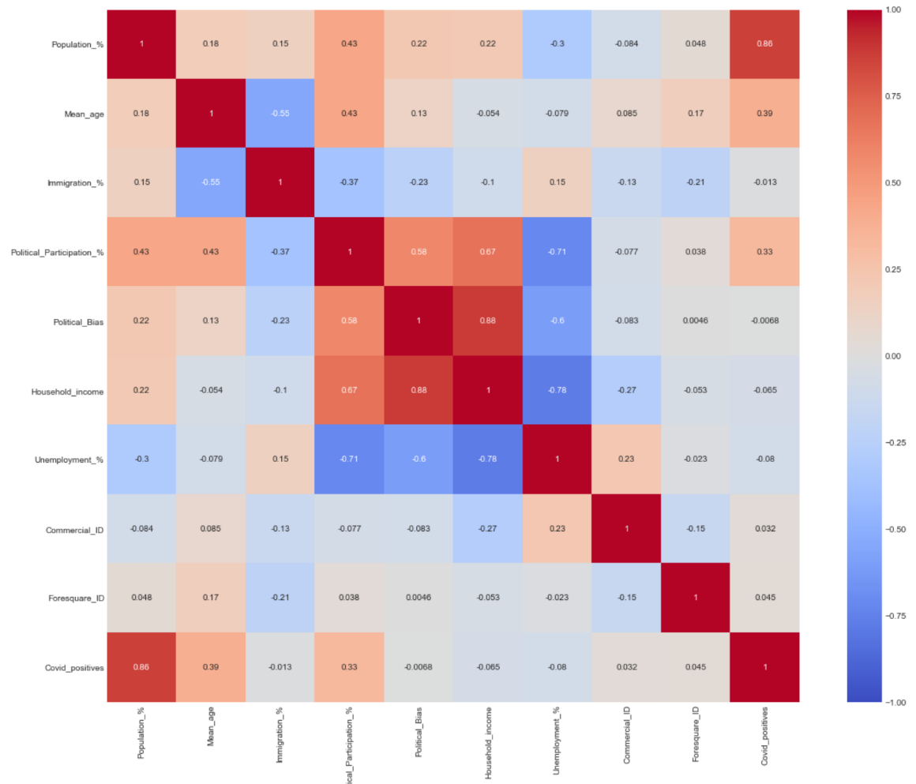
Correlation matrix
By category and considering correlations absolute values over 0.5, we can observe:
Population %: Logically, we observe a high correlation with the amount of positive cases in covid.
Mean_age: There is a weak negative correlation between mean age and immigration %.
Political Participation: We can see a mild correlation of political participation with political bias and household income. There is also a negative correlation with unemployment %.
Political bias: There is a high correlation between the political bias and the household income. There is also a negative correlation with unemployment %.
Household income: In addition to the already mentioned, there is a logical strong negative correlation with the unemployment %.
In terms of Foresquare in relation to official data, there is absolute non correlation, and therefore we can discard Foresquare as a good option for clustering and representing the city.

Slide 13
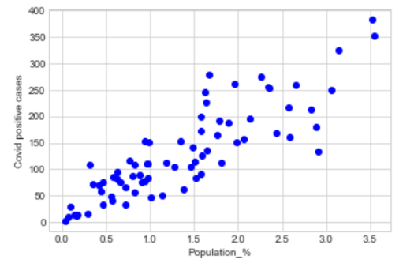
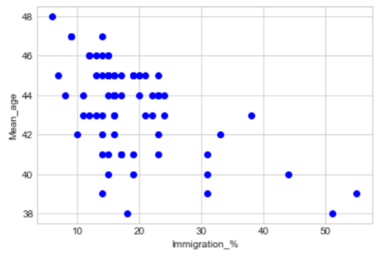
Results (I)
Tendency is not as clear, although the maximums draw a diagonal upper bound.
We can observe almost a lineal relationship.

Slide 14
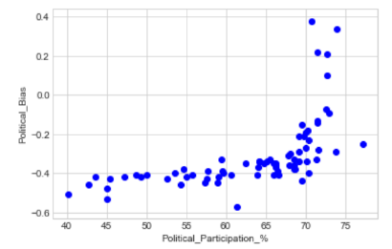
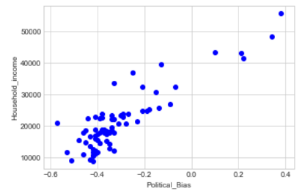
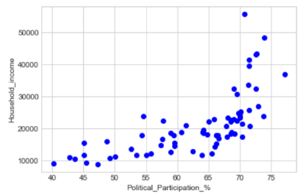
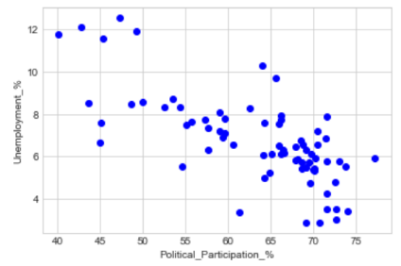
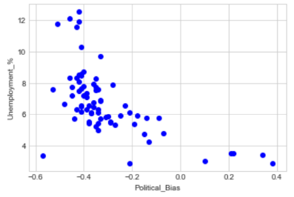
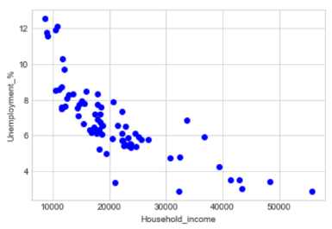
Results (II)

Slide 15
Conclusion and future directions
Barcelona hardly can be clustered based in all the demographic parameters, as for each of them you get a different painting.
Correlation was found between the tuple household income and unemployment, the political participation and the political bias.
Foresquare data not suitable for clustering
A modelling could be applied to estimate the potential number of votes a political party could get in each neighborhood.
This project aims to be repeated 2021 to observe the effects of the coronavirus and test if models based on the mentioned correlations would provide accurate predictions.

